Slide 1
Exercise session #12
4th December
Science of Climate Change
Carbon offsets
Polar climate change
23.11.2023

Slide 2
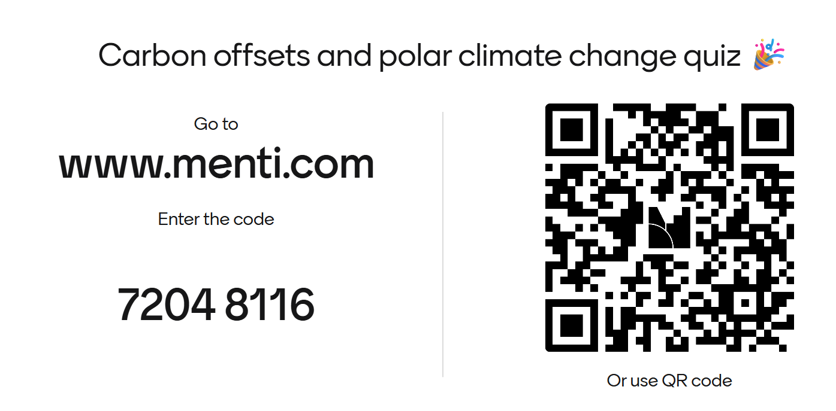
Today’s plan
Mentimeter quiz: recap of carbon offsets + Arctic Amplification
Sea ice level calculation
Time for questions and work on the poster

Slide 3
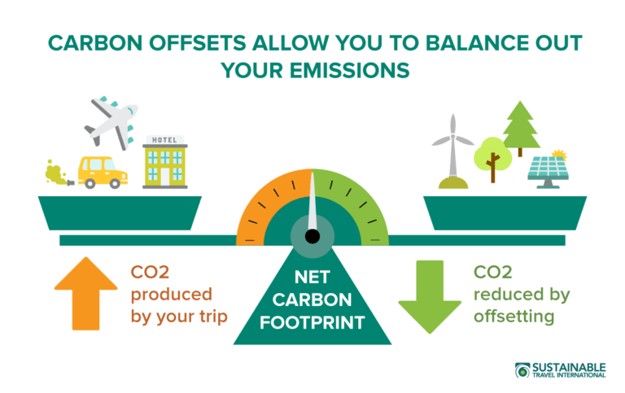
What is a carbon offset?
A carbon offset is the avoidance or sequestration of carbon dioxide or other greenhouse gases emissions to compensate for (offset) emissions produced elsewhere.
*slide 4 of lecture

Slide 4
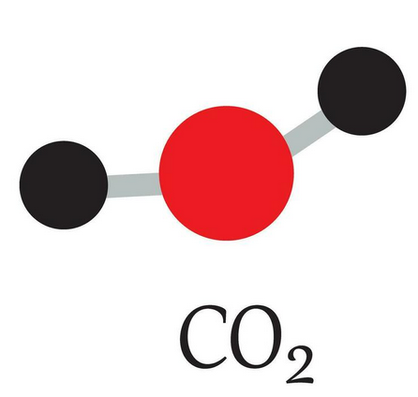
Offset strategies and sectors
There are two strategies that work with different sectors.
Avoidance
Removal
We avoid emitting CO2 all together
CO₂ is emitted but then removed from emissions
*slide 17 of lecture
Notes:
https://www.vecteezy.com/vector-art/27117761-model-of-carbon-dioxide-co2-molecule-and-chemical-formulas-geometric-structures-and-illustration-on-white-background-educational-and-study-content-of-chimestry-students-vector-illustration

Slide 5
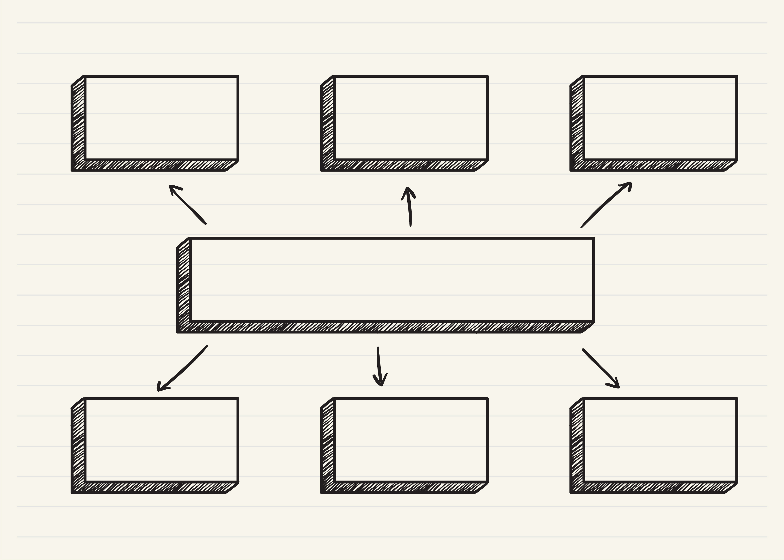
Avoidance Strategies
Energy saving measures to reduce CO2 emissions and replace fossil fuels
Energy efficiency and fuel switching
Renewable energy
Hydro, Solar, wind, nuclear
Increase energy efficiency of household devices, reduce fossil fuel burning in cookstoves for example
household devices
Water management
Invest in clean water supply and reduce need to boil water for sanitation
*based on slide 18 of lecture
Notes:
https://ecochain.com/blog/the-criteria-for-high-standard-carbon-offsetting-projects/

Slide 6
Removal Strategies
Agriculture
Forestry and Land use
Waste management
Increase agricultural practises that store carbon in soil
Improve biodiversity
Protect existing forested areas
Reforestation
Fight deforestation
Increase controls on landfill sites e.g.
Capture methane emissions released from waste
*based on slide 19 of lecture
Notes:
https://ecochain.com/blog/the-criteria-for-high-standard-carbon-offsetting-projects/

Slide 7
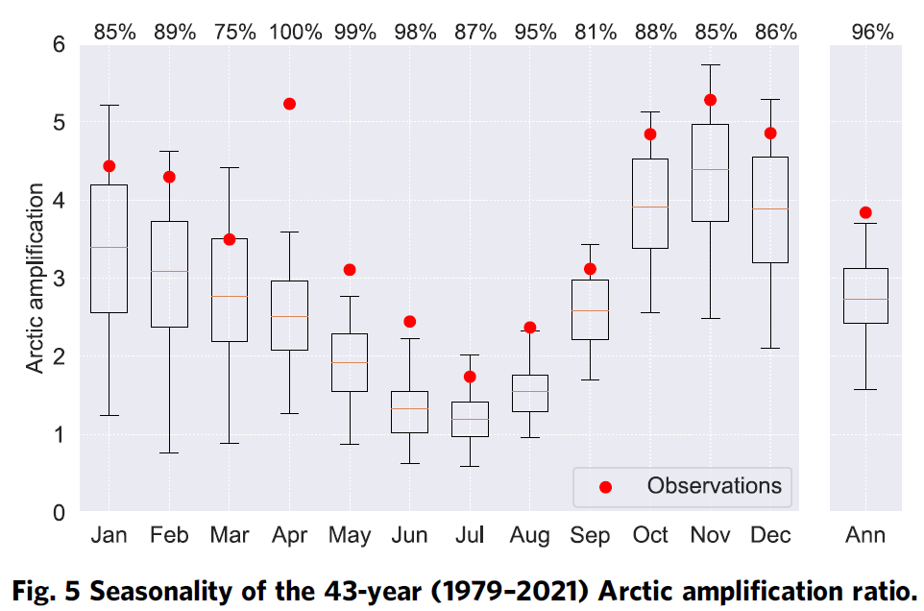
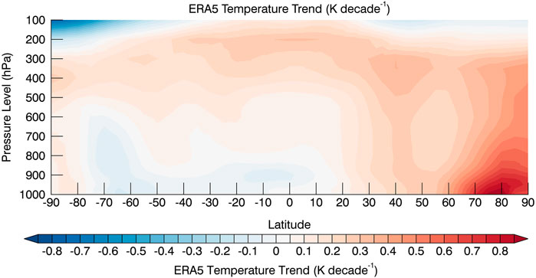
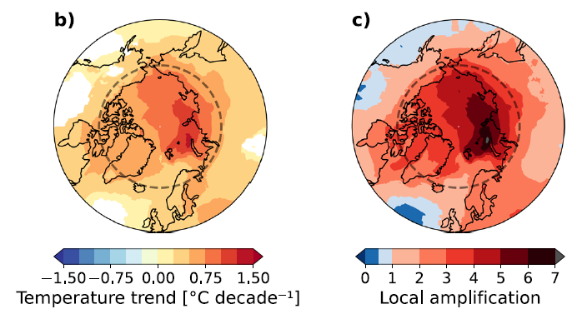
Present day Arctic Amplification
‘bottom heavy’ warming
Hersbach et al. (2019)
Arctic Amplification is largest in winter.
The absolute trends are largest in the central Arctic.
Most of the warming occurs in the lower atmosphere.
Rantanen et al. (2022)

Slide 8
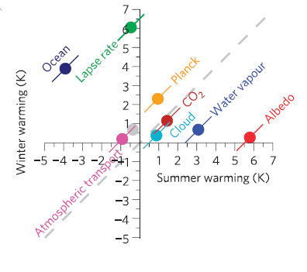
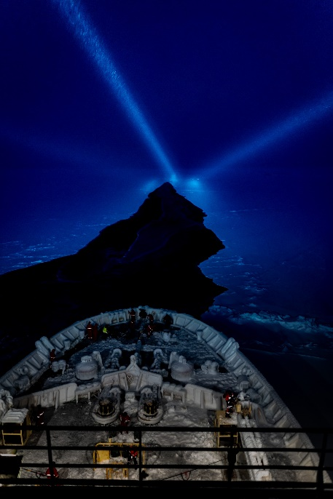
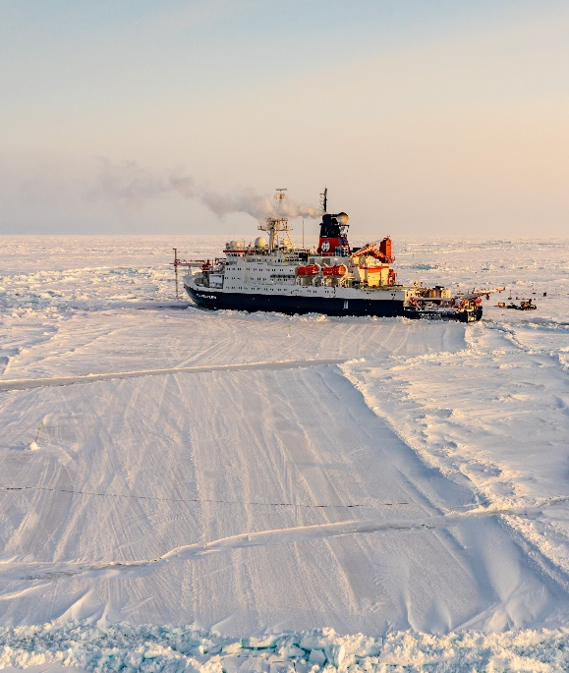
Contributions to Arctic warming
Winter – no sun
Summer – only sun
2
4
3
6
1
5
Need to distinguish winter and summer mechanisms.
Note the role that CO₂ plays.
Figure 2 |Warming contributions of individual feedback mechanisms. b, Arctic winter versus summer warming. Grey is the residual error of the decomposition.
Pithan and Mauritsen, Nat. Geoscience, 2014
Notes:
From a TOA perspective, the
surface albedo and water vapour feedbacks contribute to stronger
summer warming but are outweighed by seasonal heat storage in the
ocean and the lapse-rate feedback (Fig. 2b). Seasonal heat storage
in the ocean, including latent heat of melting sea ice, mitigates
about two-thirds of the summertime eect of surface albedo change.
Heat from the ocean is released to the atmosphere in winter,
which in combination with the positive lapse-rate feedback causes
the well-known pattern of winter-amplified Arctic warming. In
summer, when atmospheric stability ismuch weaker than in winter,
the Arctic lapse-rate feedback is actually slightly negative.

Slide 9
Ice loss in Switzerland and the Arctic
How long would it take, if we used the annual average energy that the Arctic ocean additionally absorbed due to sea ice retreat between 1980 and 2020 to melt the remaining glacier volume in Switzlerand?
Hints:
  Enthalpy of melt: 334 kJ / kg
  Density of ice: 900 kg/m³
  Volume of glaciers remaining in Switzerland: 53 km³
  Albedo of ice: 0.85
  Albedo of ocean: 0.07
You will need some data from the lecture slides (also earlier lectures).

Slide 10
Take home message
Temperatures in the Arctic are increasing 3 to 4 times faster than the rest of the world. This phenomenon is called Arctic amplification.
The Arctic amplification is more pronounced in winter and is a consequence of several feedback mechanisms, including the lapse rate and Planck feedback.
Warming of the Arctic and ice melt has strong consequences for weather and climate in the rest of the world.

